Slide 1

DETI STORE
Base de Dados
Group P2G3 - Tiago Fonseca 107266
- João Gaspar 114514
BD 2023-2024

Slide 2
Introduction
DETI Store
Online merchandising store with database with two main views
User
Admin
Create Account with 2-Step Authentication
Edit account information
Add/Remove Items from Cart
Make orders of products on carts and manage them
Make reviews on products
Manage stock of products
Add, remove and edit products to the shop
Manage client’s orders
See shop statistics
BD 2023-2024

Slide 3
Non-functional Requirements
DETI Store
Security – Provide 2FA and Emergency codes for users, securing the authentication process and their accounts
Performance – Ensure smooth usage through quick response times
Reliability – Persist during and after issues, maintaining integrity of critical information
Ease of use – Intuitive and accessible interface
BD 2023-2024
Notes:
Conseguimos garantir o 3 ponto através do uso de Transactions

Slide 4
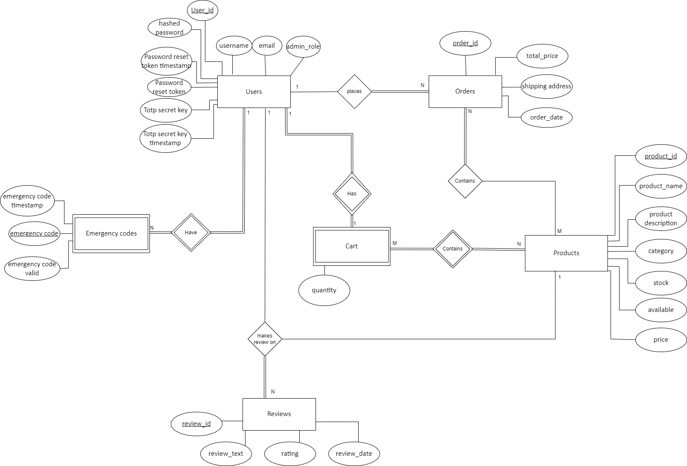
Entity-Relationship Diagram
DETI Store
Main Entities and relationships:
Users
Have Emergency Codes
Have Shopping Cart
Contains Products
Have Orders
Contains Products
Make Reviews
On Products

Slide 5
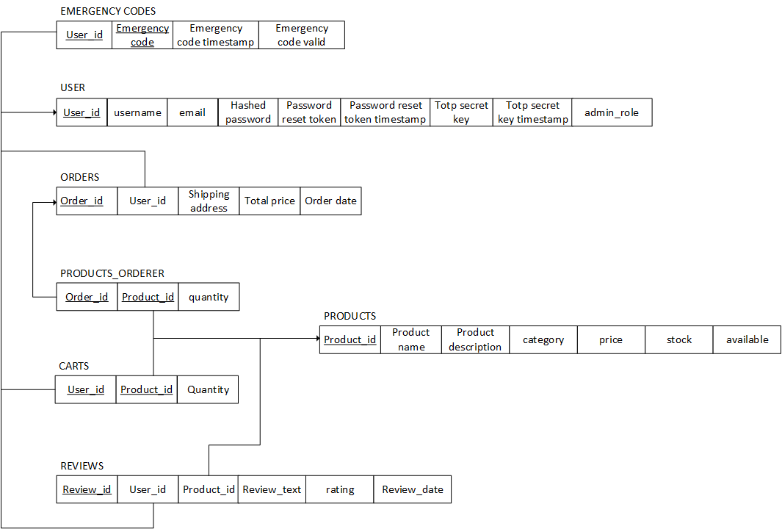
Relational Schema
DETI Store
BD 2023-2024

Slide 6
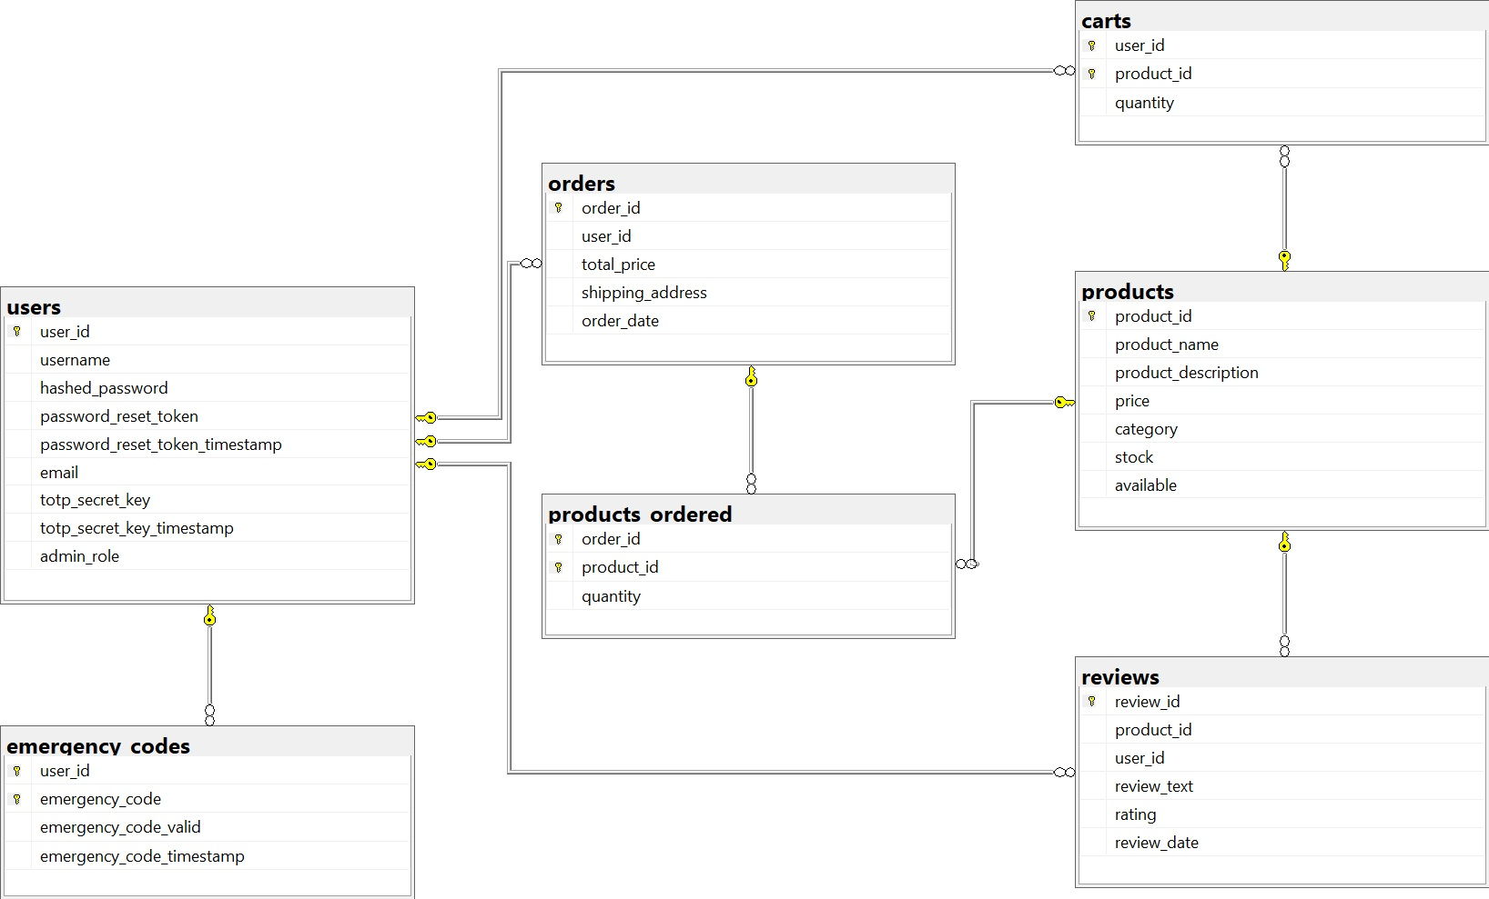
Relational Schema - SGDB
DETI Store
BD 2023-2024

Slide 7
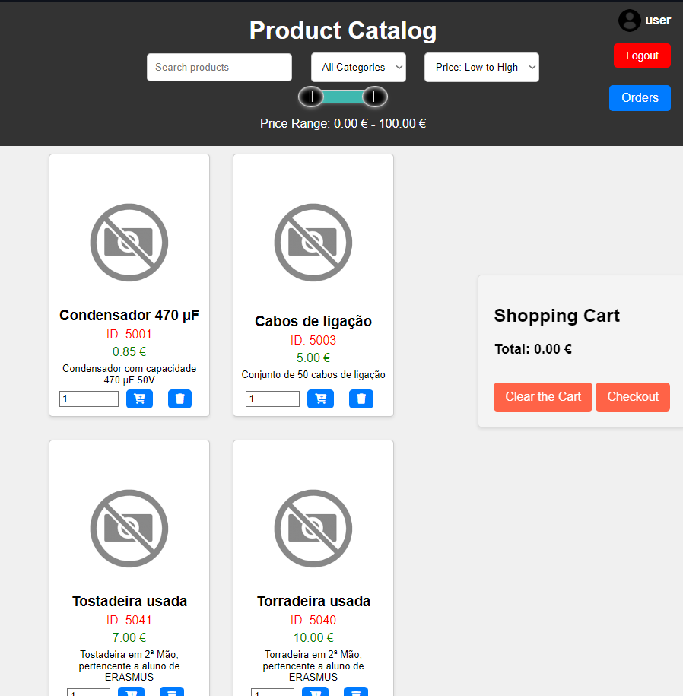
Database Resources
DETI Store
View
UDF
Available_Products
CompleteUserData
searchAvailableProducts
getProductById
Trigger
singleReviewPerUser
updateTotalOrderPrice
deleteZeroItemsCart
BD 2023-2024

Slide 8
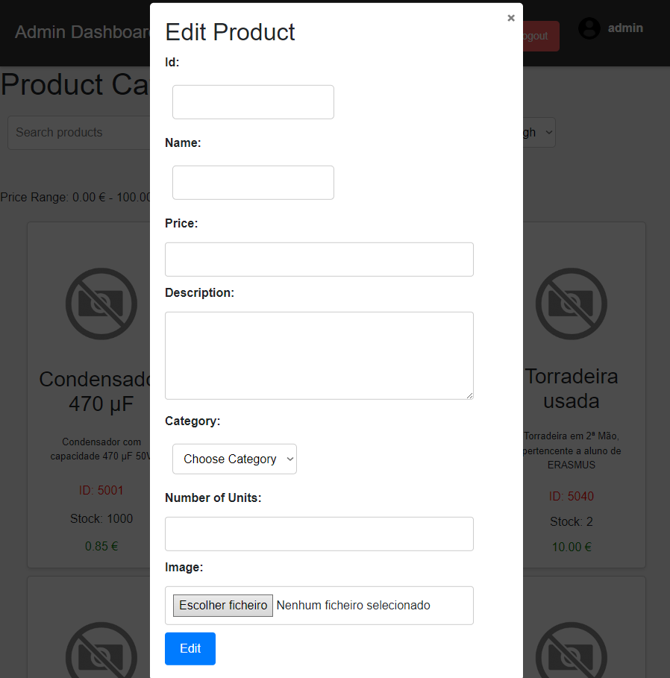
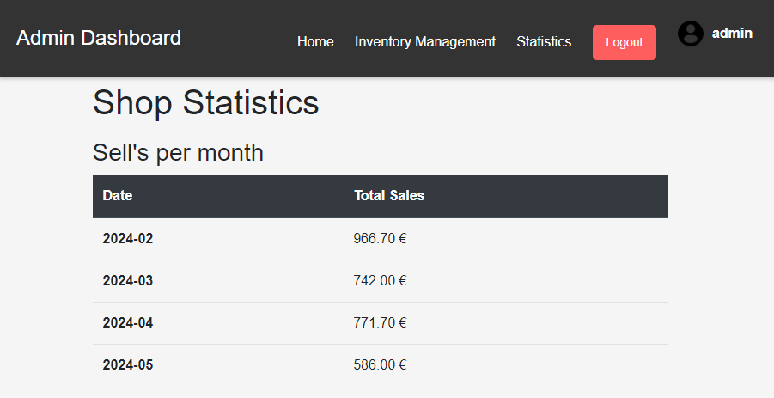
Database Resources
DETI Store
UDF
Procedures
getMonthlySalesTable
deleteUser
updateAccount
updateProduct
BD 2023-2024

Slide 9
Database Resources
DETI Store
In order to boost query’s performance we also created several useful index’s
Table | CLUSTERED INDEX’S (Primary Keys) | NON-CLUSTERED INDEX
USERS | user_id | username
PRODUCTS | product_id | product_name and category
ORDERS | order_id | user_id
PRODUCTS_ORDERED | (order_od, product_id) | None
CARTS | (user_id, product_id) | None
REVIEWS | review_id | product_id
EMERGENCY_CODES | (user_id, emergency_code) | None
BD 2023-2024

Slide 10



Technology Used
DETI Store
BD 2023-2024

Slide 11


DEMO
DETI Store
Vídeo
BD 2023-2024

